Slide 1
Computer Networks
BE Computer
Er. Anuj Sherchan
Assistant Professor , Department of Electronics and Computer Engineering
Pokhara Engineering College

Slide 2
Unit 9 : Network Management and Security
Outline:
Introduction to Network Management
Simple Network Management Protocol(SNMP)
Principles of Cryptography(Symmetric key : DES ,Asymmetric Key : RSA)
Key Exchange Protocols ( Diffie – Hellman and Kerberos)
Virtual Private Network(VPN)
Overview of IPsec
Firewall and its Types

Slide 3
Introduction to Network Management
Introduction to Network Management
Network management is defined as monitoring, testing, configuring, and troubleshooting network components to meet a set of requirements defined by an organization.
These requirements include the smooth, efficient operation of the network that provides the predefined quality of service for users.
To accomplish this task, a network management system uses hardware, software, and humans.

Slide 4
Introduction to Network Management
Functions of Network Management System
1. Configuration Management
2. Fault Management
3. Performance Management
4. Security management
5. Accounting management

Slide 5
Introduction to Network Management
Configuration Management
A large network is usually made up of hundreds of entities that are physically or logically connected to one another.
These entities have an initial configuration when the network is set up, but can change with time.
Desktop computers may be replaced by others; application software may be updated to a newer version; and users may move from one group to another.
The configuration management system must know, at any time, the status of each entity and its relation to other entities .
Configuration management can be subdivided into two parts reconfiguration and documentation.

Slide 6
Introduction to Network Management
Fault Management:
Falls on two categories.
• Reactive Fault Management
A reactive fault management system is responsible for detecting, isolating, correcting, and recording faults.
It handles short-term solutions to faults.
Proactive Fault Management
Proactive fault management tries to prevent faults from occurring.
Although this is not always possible, some types of failures can be predicted and prevented.

Slide 7
Introduction to Network Management
Performance management
It is closely related to fault management and tries to monitor and control the network to ensure that it is running as efficiently as possible.
Security Management
Security management is responsible for controlling access to the network based on the predefined policy.
Accounting Management
Accounting management is the control of users' access to network resources through charges.
Charging does not necessarily mean cash transfer; it may mean debiting the departments or divisions for budgeting purposes.

Slide 8
Introduction to Network Management
Today, organizations use an accounting management system for the following reasons:
It prevents users from monopolizing limited network resources.
It prevents users from using the system inefficiently.
Network managers can do short- and long-term planning based on the demand for network use.

Slide 9
Simple Network Management Protocol(SNMP)
Simple Network Management Protocol (SNMP)
SNMP is an "Internet-standard protocol for managing devices on IP networks.
Devices that typically support SNMP include routers, switches, servers, workstations, printers, modem racks, and more.
It is used mostly in network management systems to monitor network-attached devices for conditions that warrant administrative attention.
The Simple Network Management Protocol (SNMP) is a framework for managing devices in an Internet using the TCP/IP protocol suite.
It provides a set of fundamental operations for monitoring and maintaining an Internet.

Slide 10
Simple Network Management Protocol(SNMP)
Concept
SNMP uses the concept of manager and agent.
That is, a manager, usually a host, controls and monitors a set of agents, usually routers .
SNMP is an application-level protocol in which a few manager stations control a set of agents.
The protocol is designed at the application level so that it can monitor devices made by different manufacturers and installed on different physical networks.

Slide 11
Simple Network Management Protocol(SNMP)
Managers and Agents
A management station, called a manager, is a host that runs the SNMP client program.
A managed station, called an agent, is a router (or a host) that runs the SNMP server program.
Management is achieved through simple interaction between a manager and an agent.
The agent keeps performance information in a database.
The manager has access to the values in the database.
For example, a router can store in appropriate variables the number of packets received and forwarded.
The manager can fetch and compare the values of these two variables to see if the router is congested or not.

Slide 12
Simple Network Management Protocol(SNMP)
An SNMP-managed network consists of three key components:
Managed device
Agent — software which runs on managed devices
Network management system (NMS) — software which runs on the manager
A managed device is a network node that implements an SNMP interface that allows unidirectional (read-only) or bidirectional access to node-specific information.
Managed devices exchange node- specific information with the NMSs.
The managed devices can be any type of device, including, but not limited to, routers, access servers, switches, bridges, hubs, IP telephones, IP video cameras, computer hosts, and printers.

Slide 13
Simple Network Management Protocol(SNMP)
An agent is a network-management software module that resides on a managed device.
An agent has local knowledge of management information and translates that information to or from an SNMP specific form.
A network management system (NMS) executes applications that monitor and control managed devices.
NMSs provide the bulk of the processing and memory resources required for network management.
One or more NMSs may exist on any managed network.

Slide 14
Simple Network Management Protocol(SNMP)
Management with SNMP is based on three basic ideas:
A manager checks an agent by requesting information that reflects the behavior of the agent.
A manager forces an agent to perform a task by resetting values in the agent database.
An agent contributes to the management process by warning the manager of an unusual situation.

Slide 15
Simple Network Management Protocol(SNMP)
SNMP operates in the Application Layer of the Internet Protocol Suite (Layer 7 of the OSI model).
The SNMP agent receives requests on UDP port 161.
The manager may send requests from any available source port to port 161 in the agent.
The agent response will be sent back to the source port on the manager.
The manager receives notifications (Traps and Inform Requests) on port 162.
The agent may generate notifications from any available port.

Slide 16
Simple Network Management Protocol(SNMP)
To do management tasks, SNMP uses two other protocols:
Structure of Management Information (SMI)
Management Information Base (MIB).
Roles of SMI
SMI defines the general rules for naming objects, defining object types (including range and length), and showing how to encode objects and values.
SMI does not define the number of objects an entity should manage or name the objects to be managed or define the association between the objects and their values.
The Structure of Management Information, version 2 (SMIv2) is a component for network management. Its functions are
To name objects
To define the type of data that can be stored in an object
To show how to encode data for transmission over the network

Slide 17
Simple Network Management Protocol(SNMP)
Roles of MIB
For each entity to be managed, this protocol must define the number of objects, name them according to the rules defined by SMI, and associate a type to each named object .
MIB creates a collection of named objects, their types, and their relationships to each other in an entity to be managed.
Each agent has its own MIB2, which is a collection of all the objects that the manager can manage.
The objects in MIB2 are categorized under 10 different groups: system, interface, address translation, IP, ICMP, TCP, UDP, EGP and SNMP.

Slide 18
Simple Network Management Protocol(SNMP)
Network Management Architectures
Network management system contains two primary elements: a manager and agents.
The Manager is the console through which the network administrator performs network management functions.
Agents are the entities that interface to the actual device being managed. Bridges, Hubs, Routers or network servers are examples of managed devices that contain managed objects.
These managed objects might be hardware, configuration parameters, performance statistics etc.
These objects are arranged in what is known as a virtual information database , called a management information base, also called MIB.
SNMP allows managers and agents to communicate for the purpose of accessing these objects.

Slide 19
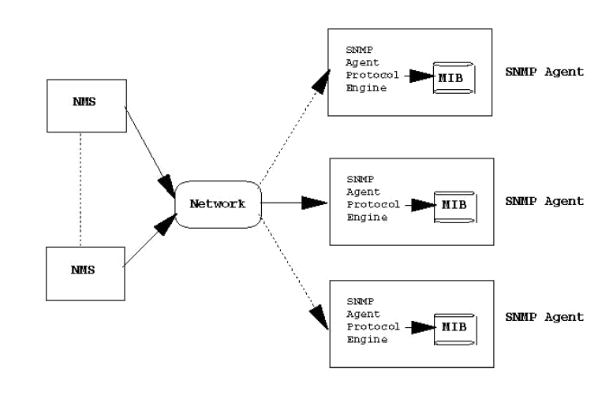
Simple Network Management Protocol(SNMP)
Fig : Network Management Architecture

Slide 20
Simple Network Management Protocol(SNMP)
A typical agent usually:
implements full SNMP protocol.
stores and retrieves management data as defined by the Management Information Base
can asynchronously signal an event to the manager
can be a proxy (The proxy agent then translates the protocol interactions it receives from the management station) for some non-SNMP manageable network node.
A typical manager usually:
implements as a Network Management Station (the NMS)
implements full SNMP Protocol
Able to
query agents
get responses from agents
set variables in agents

Slide 21
Cryptography
Cryptography
Cryptography is derived from the Greek words: Krypto's, "hidden", and gráphein, "to write" - or "hidden writing".
Cryptography is the science of using mathematics to encrypt and decrypt data.
Cryptography enables you to store sensitive information or transmit it across insecure networks (like the Internet) so that it cannot be read by anyone except the intended recipient.
While cryptography is the science of securing data, cryptanalysis is the science of analyzing and breaking secure communication.
Classical cryptanalysis involves an interesting combination of analytical reasoning, application of mathematical tools, pattern finding, patience, determination, and luck.
Cryptanalysts are also called attackers. Cryptology embraces both cryptography and cryptanalysis.

Slide 22
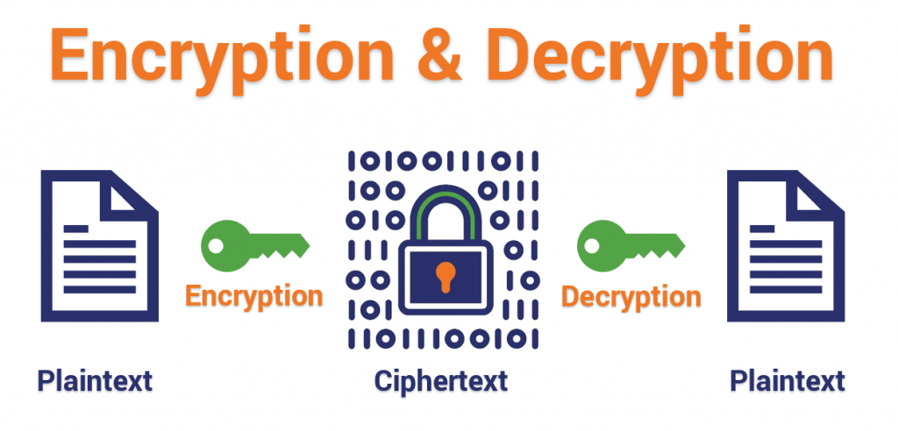
Cryptography
Encryption
Encryption is the process of translating plain text data (plain text) into something that appears to be random and meaningless (cipher text).
Decryption
Decryption is the process of converting cipher text back to plain text.

Slide 23
Cryptography
Plain-text and Cipher-text
The original message, before being transformed, is called plaintext.
After the message is transformed, it is called cipher-text.
An encryption algorithm transforms the plain text into ciphertext; a decryption algorithm transforms the cipher-text back into plain- text.
The sender uses an encryption algorithm, and the receiver uses a decryption algorithm.
Cipher
We refer to encryption and decryption algorithms as ciphers.
The term cipher is also used to refer to different categories of algorithms in cryptography.

Slide 24
Cryptography
Key
A key is a number (or a set of numbers) that the cipher, as an algorithm, operates on.
To encrypt a message, we need an encryption algorithm, an encryption key, and the plain-text.
These create the cipher-text.
To decrypt a message, we need a decryption algorithm, a decryption key, and the cipher- text.
These reveal the original plain-text.

Slide 25
Cryptography
Alice, Bob, and Eve
In cryptography, it is customary to use three characters in an information exchange scenario; we use Alice, Bob, and Eve.
Alice is the person who needs to send secure data.
Bob is the recipient of the data.
Eve is the person who somehow disturbs the communication between Alice and Bob by intercepting messages to uncover the data or by sending her own disguised messages.
These three names represent computers or processes that actually send or receive data, or intercept or change data.

Slide 26
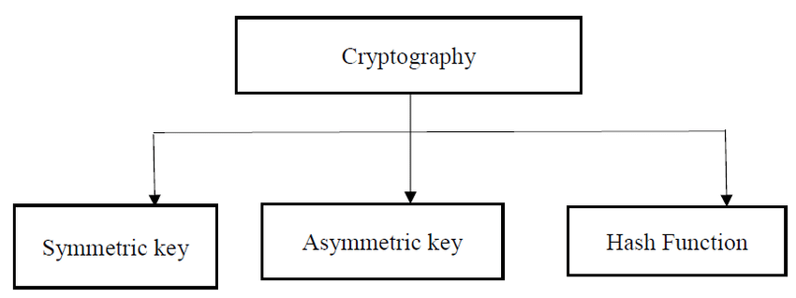
Cryptography
Types of Cryptography
Symmetric Key Cryptography(Secret key)
Asymmetric Key Cryptography(Public key)

Slide 27
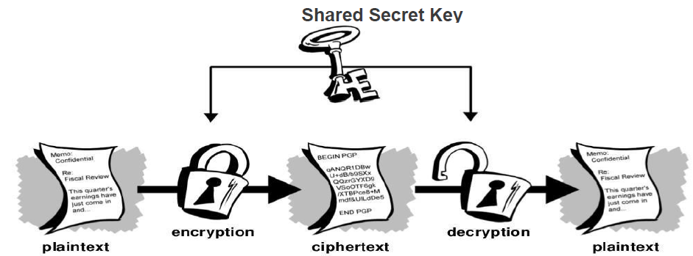
Cryptography
Symmetric-key
In conventional cryptography, also called secret-key or symmetric-key encryption, one key is used both for encryption and decryption.
The Data Encryption Standard (DES) is an example of a conventional cryptosystem that is widely employed by the Federal Government.
Figure below shows an illustration of the conventional encryption process.
Fig : Symmetric Key Cryptography

Slide 28
Cryptography
Conventional encryption has benefits.
It is very fast.
It is especially useful for encrypting data that is not going anywhere.
However, conventional encryption alone as a means for transmitting secure data can be quite expensive simply due to the difficulty of secure key distribution.
For a sender and recipient to communicate securely using conventional encryption, they must agree upon a key and keep it secret between themselves.
If they are in different physical locations, they must trust a courier, the Bat Phone, or some other secure communication medium to prevent the disclosure of the secret key during transmission.
Anyone who overhears or intercepts the key in transit can later read, modify, and forge all information encrypted or authenticated with that key.

Slide 29
Cryptography
Asymmetric-Key
Public key cryptography is an asymmetric scheme that uses a pair of keys for encryption: a public key, which encrypts data, and a corresponding private, or secret key for decryption.
You publish your public key to the world while keeping your private key secret.
Anyone with a copy of your public key can then encrypt information that only you can read .
It is computationally infeasible to deduce the private key from the public key.
Anyone who has a public key can encrypt information but cannot decrypt it.
Only the person who has the corresponding private key can decrypt the information.

Slide 30
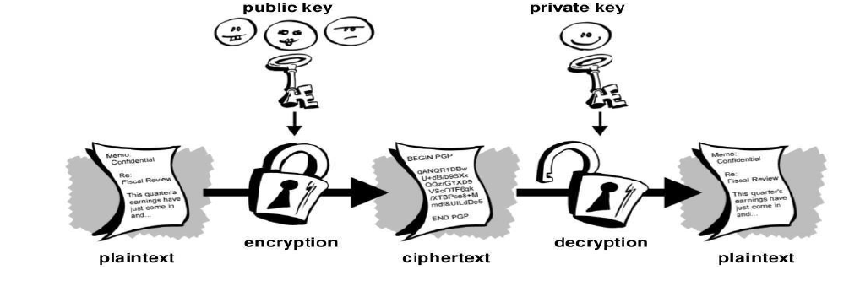
Cryptography
Fig : Asymmetric Key Cryptography

Slide 31
Cryptography
The Essential steps in Asymmetric-key cryptography are the following:
Each user generates a pair of keys to be used for the encryption and decryption of messages.
Each user places one of the keys in a public register or other accessible file.
This is the public key.
The companion key is kept private.
Each user maintains a collection of public keys obtained from others.
If Bob wishes to send a private message to Alice, Bob encrypts the message using Alice's public key.
When Alice receives the message, she decrypts it using her private key.
No other recipient can decrypt the message because only Alice knows the Alice's private key.

Slide 32
Cryptography
With this approach, all the participants have access to public keys, and private keys are generated locally by each participant and therefore need never be distributed.
As long as a user protects his and her private key, incoming communication is secure.
At any time, a user change the private key and publish the companion public key replace the old public key.

Slide 33
Cryptography
Traditional Cipher used in Symmetric-key Cryptography:
Two types:
Substitution cipher
Transposition cipher
Substitution cipher:
A substitution cipher substitutes one symbol with another.
If the symbols in the plain- text are alphabetic characters, we replace one character with another.
For example, we can replace character A with D, and character T with Z.
If the symbols are digits (0 to 9), we can replace 3 with 7, and 2 with 6.
It is also known and Caesar's Cipher who invented it.

Slide 34
Cryptography
For example, if we encode the word “SECRET” using Caesar’s key value of 3, we offset the alphabet so that the 3rd letter down (D) begins the alphabet.
So starting with ABCDEFGHIJKLMNOPQRSTUVWXYZ and sliding everything up by 3, you get DEFGHIJKLMNOPQRSTUVWXYZABC
where D=A, E=B, F=C, and so on.
Using this scheme, the plaintext, “SECRET” encrypts as “VHFUHW.”
To allow someone else to read the ciphertext, you tell them that the key is 3.

Slide 35
Cryptography
Transposition Ciphers
In a transposition cipher, there is no substitution of characters; instead, their locations change. A character in the first position of the plaintext may appear in the tenth position of the ciphertext.
A character in the eighth position may appear in the first position.
In other words, a transposition cipher reorders the symbols in a block of symbols.
Key In a transposition cipher, the key is a mapping between the position of the symbols in the plaintext and cipher text.
For example, the following shows the key using a block of four characters:
Plaintext: 2 4 1 3
Ciphertext: 1 2 3 4

Slide 36
Cryptography
Encryption algorithm:
The most commonly used symmetric encryption are block ciphers.
A block cipher processes the plain text input in fixed size blocks and produces a block of cipher text of equal size for each plain text block.
The two most important symmetric algorithms, both of which are block ciphers, are
Data Encryption Standard (DES)
Advanced Encryption Standard (AES)

Slide 37
Cryptography
Data Encryption Standard (DES)
The Data Encryption Standard (DES)is a symmetric-key block cipher published by the National Institute of Standards and Technology (NIST).
DES is an implementation of a Feistel Cipher.
It uses 16 round Feistel structure.
The block size is 64-bit.
Though, key length is 64-bit,
DES has an effective key length of 56 bits, since 8 of the 64 bits of the key are not used by the encryption algorithm (function as check bits only).
General Structure of DES is depicted in the following illustration −

Slide 38
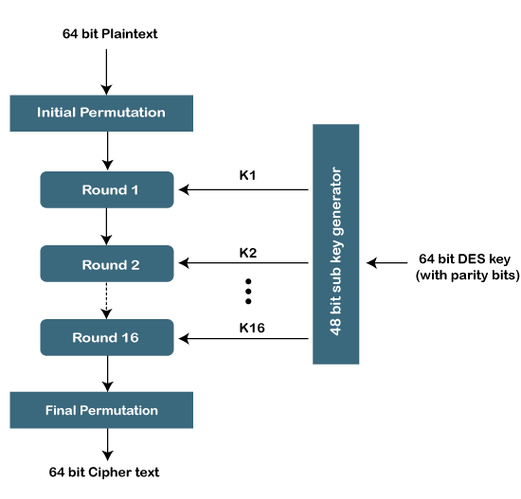
Cryptography
Fig :Structure of DES Algorithm

Slide 39
Cryptography
It encrypts the data using the first key (k1), decrypts the data by using the second key (k2) and again encrypts the data by using the third key (k3).
Another variant of the algorithm uses only two keys k1 and k3. where both the keys k1 and k3 are the same.
It is used still but considered as a legacy algorithm.

Slide 40
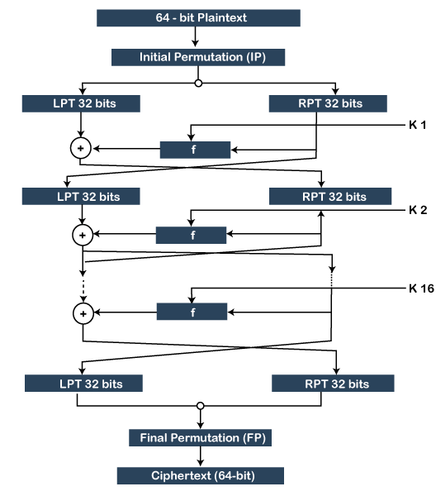
Cryptography
Fig : DES Algorithm

Slide 41
DES Algorithm
The algorithm includes the following steps:
The algorithm takes the 64-bit plain text as input.
The text is parsed into a function called the Initial Permutation (IP) function.
The initial permutation (IP) function breaks the plain text into the two halves of the permuted block.
These two blocks are known as Left Plain Text (LPT) and Right Plain Text (RPT).
The 16 round encryption process is performed on both blocks LPT and RPT.
The encryption process performs the following:
Key Transformation
Expansion Permutation
S-Box Permutation
P-Box Permutation
XOR and Swap

Slide 42
DES Algorithm
After performing the encryption process, the LPT and RPT block are rejoined. After that, the Final Permutation (FP) is applied to the combined block.
Finally, we get the 64-bit ciphertext of the plaintext.

Slide 43
Cryptography
RSA Encryption Algorithm
RSA is the most common public-key algorithm, named after its inventors Rivest, Shamir, and Adelman (RSA).
The RSA algorithm is an asymmetric cryptography algorithm; this means that it uses a public key and a private key (i.e. two different, mathematically linked keys).
As their names suggest, a public key is shared publicly, while a private key is secret and must not be shared with anyone.

Slide 44
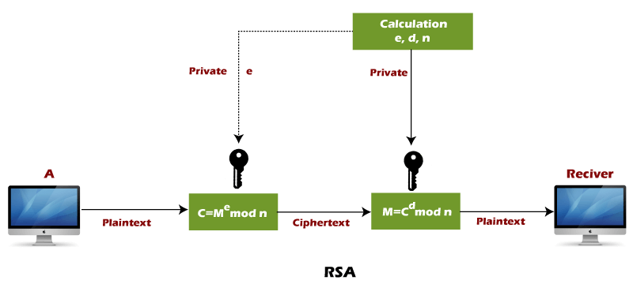
Cryptography

Slide 45
Cryptography
Steps for RSA Algorithm:
Select two large prime numbers, p and q.
Multiply these numbers to find n = p x q, where n is called the modulus for encryption and decryption.
Choose a number e less than n, such that n is relatively prime to (p - 1) x (q -1).
It means that e and (p - 1) x (q - 1) have no common factor except 1.
Choose “e” such that 1<e < φ (n), e is prime to φ (n), gcd (e,d(n)) =1
If n = p x q, then the public key is <e, n>.
A plaintext message m is encrypted using public key <e, n>.
To find cipher text from the plain text following formula issued to get cipher text C. C = m^{e} mod n

Slide 46
Cryptography
Here, m must be less than n.
A larger message (>n) is treated as a concatenation of messages, each of which is encrypted separately.
To determine the private key, we use the following formula to calculate the d such that:
Calculate d=e^-1mod φ (n)
e d =mod φ (n)
ed mod φ (n)= 1
d= (1+k φ (n)/e)
The private key is <d, n>.
A ciphertext message c is decrypted using private key <d, n>.
To calculate plain text m from the ciphertext c following formula is used to get plain text m. m = c^{d} mod n

Slide 47
Cryptography
Example 1:
This example shows how we can encrypt plaintext 9 using the RSA public-key encryption algorithm. This example uses prime numbers 7 and 11 to generate the public and private keys.
Explanation:
Step 1: Select two large prime numbers, p, and q.
p = 7
q = 11
Step 2: Multiply these numbers to find n = p x q, where n is called the modulus for encryption and decryption.

Slide 48
Cryptography
First, we calculate n = p x q = 7 x 11=77
Step 3: Choose a number e less that n, such that n is relatively prime to (p - 1) x (q -1).
It means that e and (p - 1) x (q - 1) have no common factor except 1.
Choose "e" such that 1<e < φ (n), e is prime to φ (n), gcd (e,d(n)) =1. Second, we calculate φ (n) = (p - 1) x (q-1)
φ (n) = (7 - 1) x (11 - 1)
φ (n) = 6 x 10=60
Let us now choose relative prime e of 60 as 7.
Thus the public key is <e, n> = (7, 77)

Slide 49
Cryptography
Step 4: A plaintext message m is encrypted using public key <e, n>.
To find ciphertext from the plain text following formula is used to get ciphertext C.
To find ciphertext from the plain text following formula is used to get ciphertext C.
C = m^{e} mod n
C = 9⁷ mod 77
C = 37
Step 5: The private key is <d, n>. To determine the private key, we use the following formula d such that:
ed mod φ (n)= 1 [d=(1+k φ (n)/e)]
7d mod 60 = 1, which gives d = 43
The private key is <d, n> = (43, 77)

Slide 50
Cryptography
Step 6: A ciphertext message c is decrypted using private key <d, n>. To calculate plain text m from the ciphertext c following formula is used to get plain text m.
m = c^{d} mod n
m = 37⁴³ mod 77
m = 9
In this example, Plain text = 9 and the ciphertext = 37
Example 2:
In an RSA cryptosystem, a particular A uses two prime numbers, 13 and 17, to generate the public and private keys. If the public of A is 35. Then the private key of A is ……………?.

Slide 51
Key Exchange Protocols
Kerberos
Kerberos is a network authentication protocol designed to provide strong authentication for client/server applications by means of secret-key cryptography.
Kerberos ensures the highest level of security to network resources.
The Kerberos protocol name is based on the three- headed dog figure from Greek mythology known as Kerberos.
Components of Kerberos:
Key Distribution Center (KDC),
Client User,
and Server with the desired service to access.

Slide 52
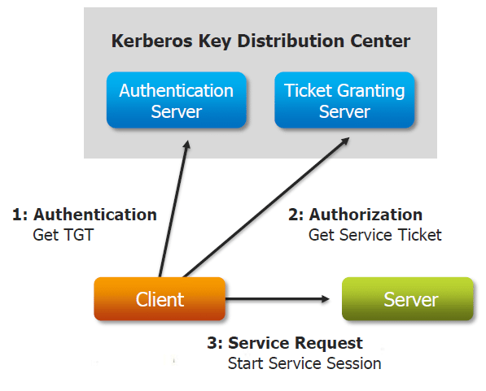
Key Exchange Protocols

Slide 53
Key Exchange Protocols
The KDC performs 2service functions:
Authentication Service (AS)
Ticket-Granting Service (TGS)
As shown in the above figure, three exchanges occurs when the client accesses a server:
AS Exchange
TGS Exchange
Client/Server (CS) Exchange

Slide 54
Key Exchange Protocols
How Does Kerberos Work?
Instead of client sending password to application server, a Request Ticket is placed from authentication server and the Ticket along with the encrypted request is sent to application server.
Now, how to request tickets without repeatedly sending credentials?
This is done through Ticket granting ticket (TGT).

Slide 55
Key Exchange Protocols
Diffie-Hellman key exchange protocol
Diffie-Hellman Key Exchange is a technique of securely transferring cryptographic keys over a public channel, devised by Ralph Merkle and named after Whitfield Diffie and Martin Hellman, and was one of the earliest public-key protocols.
Diffie-Hellman Key Exchange is one of the earliest practical examples of public key exchange.
This is the oldest publicly known paper that proposed the idea of a private key and a corresponding public key.
It was published in 1976 by Diffie and Hellman.
The point is to agree on a key that two parties can use for symbolic encryption in such a way that eavesdropper cannot obtain the key.

Slide 56
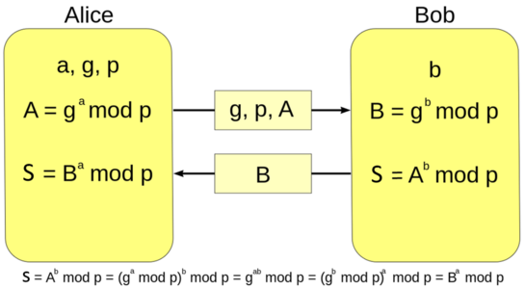
Key Exchange Protocols
Fig : Diffie Hellman Key Exchange Algorithm

Slide 57
Key Exchange Protocols
Steps
Alice and Bob agree on prime number p and a base g.
Alice chooses a secret number a , and sends Bob (g^a mod p).
Bob chooses a secret number b and sends Alice (g^b mod p).
Alice computes ((g^b mod p)^a mod p)
Bob computes ((g^a mod p)^b mod p)
Both Alice and Bob can use this number as their key.
Notice that p and g need not be protected

Slide 58
Key Exchange Protocols
Example
Alice and Bob agree on p=23 and g=5
Alice chooses a=6 and sends 5^6 mod 23=8
Bob chooses b=15 and sends 5^15 mod 23=19
Alice computes 19^6 mod 23 =2
Bob computes 8^15 mod 23=2
Then 2 is the shared secret
Clearly , much larger values of a ,b , p are required .
An eaves dropper cannot discover this value even if she knows p and g and can obtain each of the messages.

Slide 59
Virtual Private Network (VPN)
Virtual Private Network (VPN)
The Internet is a worldwide, publicly accessible IP network.
Due to its vast global proliferation, it has become a viable method of interconnecting remote sites.
However, the fact that it is a public infrastructure has deterred most enterprises from adopting it as a viable remote access method for branch and SOHO sites.
A virtual private network (VPN) is a concept that describes how to create a private network over a public network infrastructure while maintaining confidentiality and security.
VPNs use cryptographic tunneling protocols to provide sender authentication, message integrity, and confidentiality by protecting against packet sniffing.
VPNs can be implemented at Layers 2, 3, and 4 of the Open Systems Interconnection (OSI) model.

Slide 60
Virtual Private Network (VPN)
Components required to establish a VPN include:
An existing network with servers and workstations
Connection to the Internet
VPN gateways (i.e., routers, PIX, ASA, VPN concentrators) that act as endpoints to establish, manage, and control VPN connections
Software to create and manage tunnels
VPNs secure data by encapsulating the data, encrypting the data, or both encapsulating the data and then encrypting it:
• Encapsulation is also referred to as tunneling because encapsulation transmits data transparently from network to network through a shared network infrastructure.
• Encryption codes data into a different format.
Decryption decodes encrypted data into the data’s original unencrypted format.

Slide 61
Virtual Private Network (VPN)
Fig:(a) A leased-line private network. (b) A virtual private network.
Fig : VPN Topology

Slide 62
Virtual Private Network (VPN)
Basically, a VPN is a private network that uses a public network (usually the internet) to connect remote sites or users together.
Instead of using a dedicated, real-world connection such as leased line, a VPN uses "virtual" connections routed through the internet from the company's private network to the remote site or employee.
A well-designed VPN can greatly benefit a company. For example, it can:
• Extend geographic connectivity
• Improve security
• Reduce operational costs versus traditional WAN
• Reduce transit time and transportation costs for remote users
• Improve productivity
• Simplify network topology
• Provide global networking opportunities
• Provide broadband networking compatibility

Slide 63
IPsec (IP security)
IPsec provides a mechanism for secure data transmission over IP networks, ensuring confidentiality, integrity, and authenticity of data communications over unprotected networks such as the Internet .
IPsec encompasses a suite of protocols and is not bound to any specific encryption or authentication algorithms, key generation technique, or security association (SA).
IPsec provides the rules while existing algorithms provide the encryption, authentication, key management, and so on.
IPsec acts at the network layer, protecting and authenticating IP packets between IPsec devices (peers), such as Cisco PIX Firewalls, Adaptive Security Appliances (ASA), Cisco routers, the Cisco Secure VPN Client, and other IPsec-compliant products.
IPsec is an Internet Engineering Task Force (IETF) standard (RFC 2401-2412) that defines how a VPN can be created over IP networks.

Slide 64
IPsec
IPsec provides the following essential security functions:
Data confidentiality: IPsec ensures confidentiality by using encryption.
Data encryption prevents third parties from reading the data, especially data that is transmitted over public networks or wireless networks.
The IPsec sender can encrypt packets before transmitting the packets across a network and prevent anyone from hearing or viewing the communication (eavesdropping).
Data integrity: IPsec ensures that data arrives unchanged at the destination; that is, that the data is not manipulated at any point along the communication path.
IPsec ensures data integrity by using hashes.
Data origin authentication: The IPsec receiver can authenticate the source of the IPsec packets.
Authentication ensures that the connection is actually made with the desired communication partner

Slide 65
Firewall
Firewall
Any system or device that allows safe network traffic to pass while restricting or denying unsafe traffic.
Firewalls are usually dedicated machines running at the gateway point between your local network and the outside world, and are used to control who has access to your private corporate network from the outside—for example, over the Internet.
More generally, a firewall is any system that controls communication between two networks.
In today’s networking environment in which corporate networks are connected to the internet— inviting hackers to attempt unauthorized access to valuable business information—a corporate firewall is essential.

Slide 66
Firewall
Types of Firewall
Network Level Firewall:
The simple firewall is sometimes called a network-level firewall because it operates at the network layer of the Open Systems Interconnection (OSI) reference model for networking.
Network-level firewalls are transparent users and use routing technology to determine which packets are allowed to pass and which will be denied access to the private network.
Network-level firewalls implemented solely on stand-alone routers are called packet-filtering routers or screening routers.
In its simplest form, a firewall is essentially a kind of router or computer with two network interface cards that filters incoming network packets.

Slide 67
Firewall
Fig : Network Layer Firewall

Slide 68
Firewall
Circuit-level Firewall:
Another type of firewall is a circuit-level gateway, which is usually a component of a proxy server.
Circuit- level gateways essentially operate at a higher level of the OSI model protocol stack than network-level firewalls do.
With a circuit-level firewall, connections with the private network are hidden from the remote user.
The remote user connects with the firewall, and the firewall forms a separate connection with the network resource being accessed after changing the IP address of the packets being transmitted in either direction through the firewall.
The result is a sort of virtual circuit between the remote user and the network resource..
A popular protocol for circuit-level gateways is the SOCKS v5 protocol.

Slide 69
Firewall
Application Level Firewall:
Another more advanced type of firewall is the application-level firewall (or application gateway), which is also usually a component of a proxy server.
Application gateways do not allow any packets to pass directly between the two networks they connect.
Instead, proxy applications running on the firewall computer forward requests to services on the private network, and then forward responses to the originators on the unsecured public network
Application gateways generally require some configuration on the part of users to enable their client machines to function properly, but they are more atomic in their configurability than network-level firewalls.

Slide 70
Firewall
For example, if a File Transfer Protocol (FTP) proxy is configured on an application gateway, it can be configured to allow some FTP commands but deny others.
You could also configure an SMTP proxy on an application gateway that would accept mail from the outside (without revealing internal e-mail addresses), and then forward the mail to the internal mail server.
However, because of the additional processing overhead, application gateways have greater hardware requirements and are generally slower than network-level firewalls.

Slide 71
Firewall

Slide 72
Next generation Network(NGN)
Next Generation Network (NGN) refers to a packet-based network and it can be used for both telecommunication services as well as data and it supports mobility.
It is able to make use of multiple broadband capabilities, especially Quality of Services (QoS) enabled transport technologies where the service-related functions are independent of the underlying transport-related technologies.
The main goal of Next Generation Network (NGN) is to serve/work as an replacement of Public Switched Telephone Network (PSTN)and Integrated Services Digital Network (ISDN).
International Telecommunication Union Telecommunication Standardization Sector (ITU-T) defines Next Generation Network (NGN) is a packet based network which provides telecommunication services to users and it uses multiple broadbands, QoS enabled transport technologies.
NGN is a generalized mobility approach and it allows consistent and all over-provision of services to users.

Slide 73
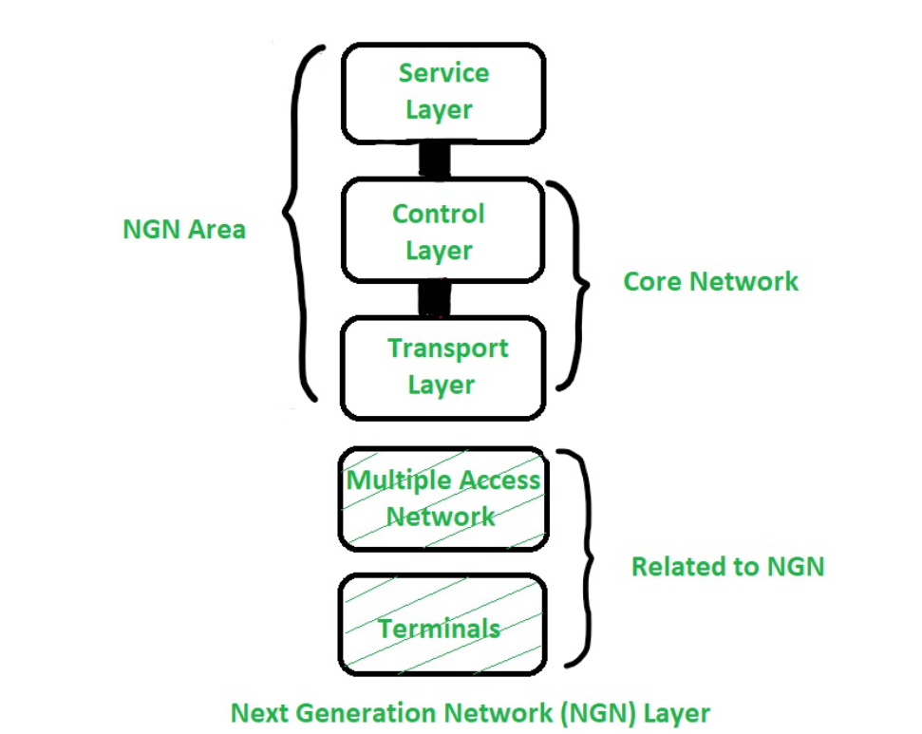
Next generation Network(NGN)

Slide 74
Next generation Network(NGN)
Next Generation Network Layer :
In Access Layer, different types of media gateways that support connection to and from access network with the core network are included.
Core network layer is network handling converged services based on Internet Protocol (IP). Control layer works as call server. It provides call control functions also provides control of a media gateway.
Service layer is an IT platform that creates a service creation environment extending its functionality in order to cover new network scenarios as an intelligent network.

Slide 75
Next generation Network(NGN)
This basic reference model separated Transport layer (Access and Core) from Service layer.
In short Access Layer elements handles different media gateways. Core Layer handles networks based on IP.
Control Layer handles call control functions and control of media gateways.
Service Layer is an IT platform that plays role of an Intelligent Network Service Creation Environment

Slide 76
THANK YOU

